Slide 1
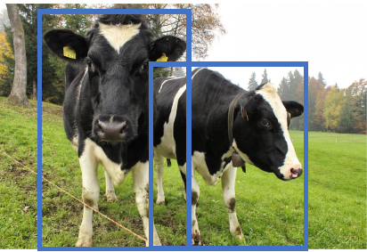
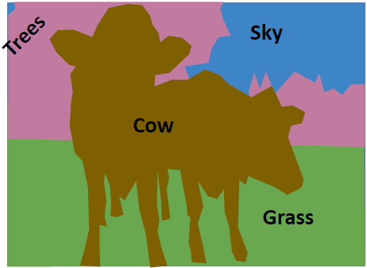
L4 Object Detection and Segmentation
Zonghua Gu 2022
Acknowledgement: Based EECS 498 Deep Learning for Computer Vision, U Michigan

Slide 2
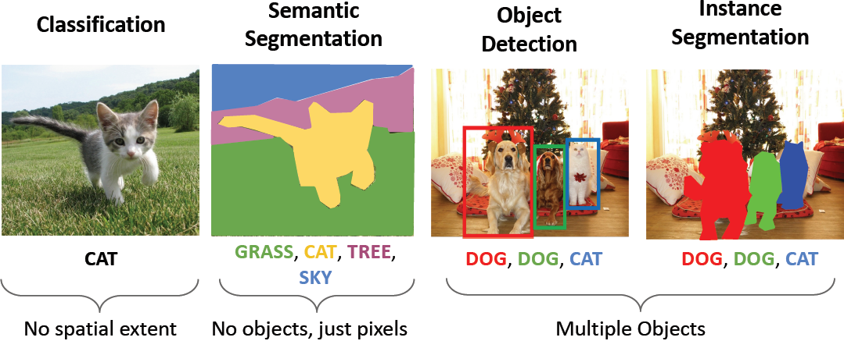
Computer Vision Tasks

Slide 3
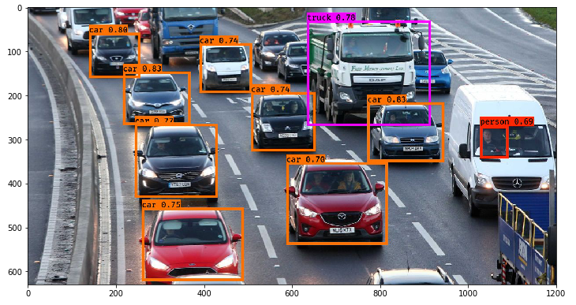
Outline
Object detection
Segmentation
Notes:
https://towardsdatascience.com/object-detection-using-deep-learning-approaches-an-end-to-end-theoretical-perspective-4ca27eee8a9a

Slide 4
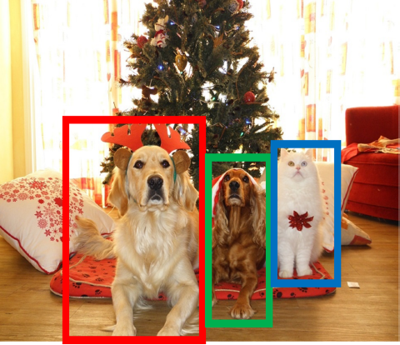
Object Detection: Task Definition
Input: Single Image
Output: a set of detected objects
For each object predict:
WHAT: Class label (e.g., cat vs. dog)
WHERE: Bbox (4 numbers: x, y, width, height)
Challenges:
Multiple outputs: variable numbers of objects per image
Multiple types of output: predict ”what” (class label) as well as “where” (Bbox)
Large images: Classification works at 224x224 or lower; need higher resolution for detection, often ~800x600
Notes:
WHATs and WHEREs of the objects

Slide 5
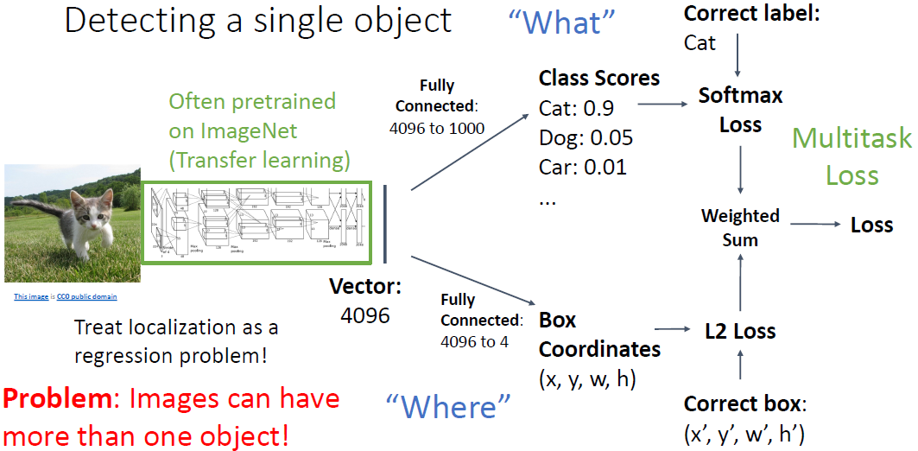
Single-Object Detection

Slide 6
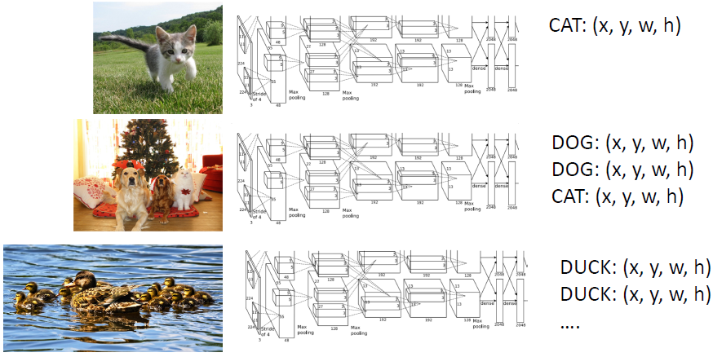
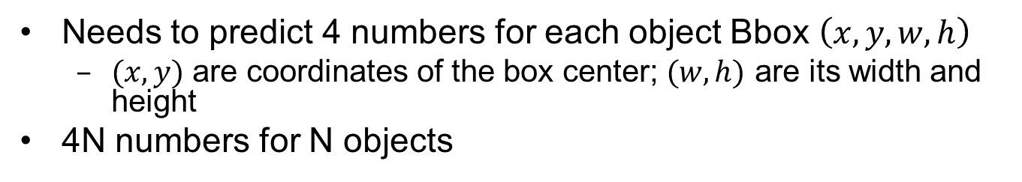
Multi-Object Detection
Needs to predict 4 numbers for each object Bbox $\left(x, y, w, h\right)$
$(x, y)$ are coordinates of the box center; $(w, h)$ are its width and height
4N numbers for N objects

Slide 7
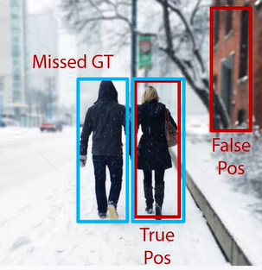
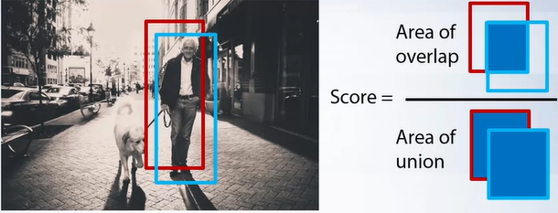
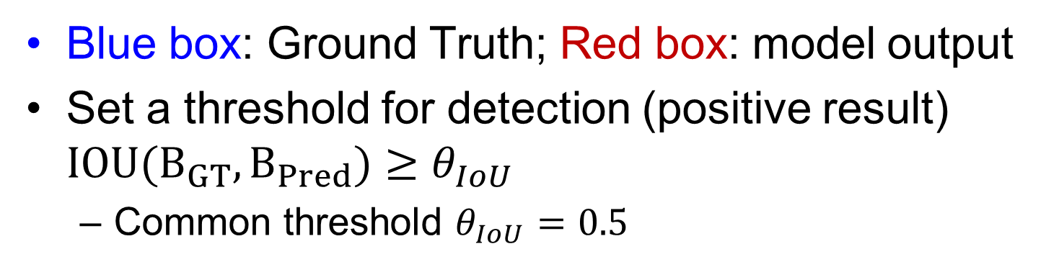
Detection Criteria (Intersection Over Union, IOU)
Blue box: Ground Truth; Red box: model output
Set a threshold for detection (positive result) $IOU(B_{GT},B_{Pred})≥θ_{IoU}$
Common threshold $θ_{IoU}=0.5$

Slide 8
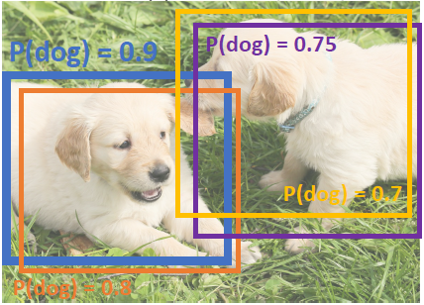
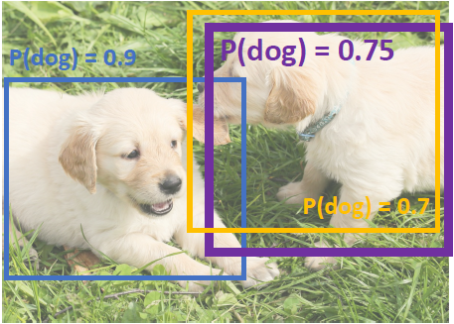
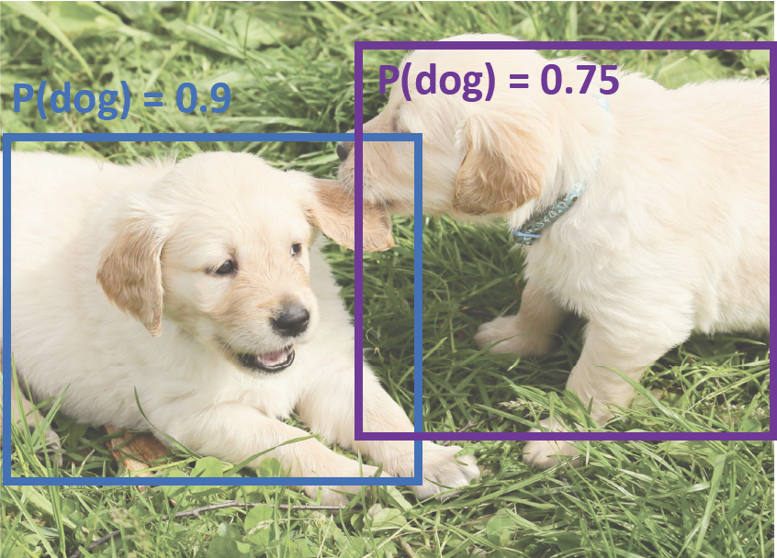
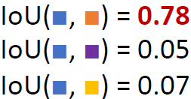

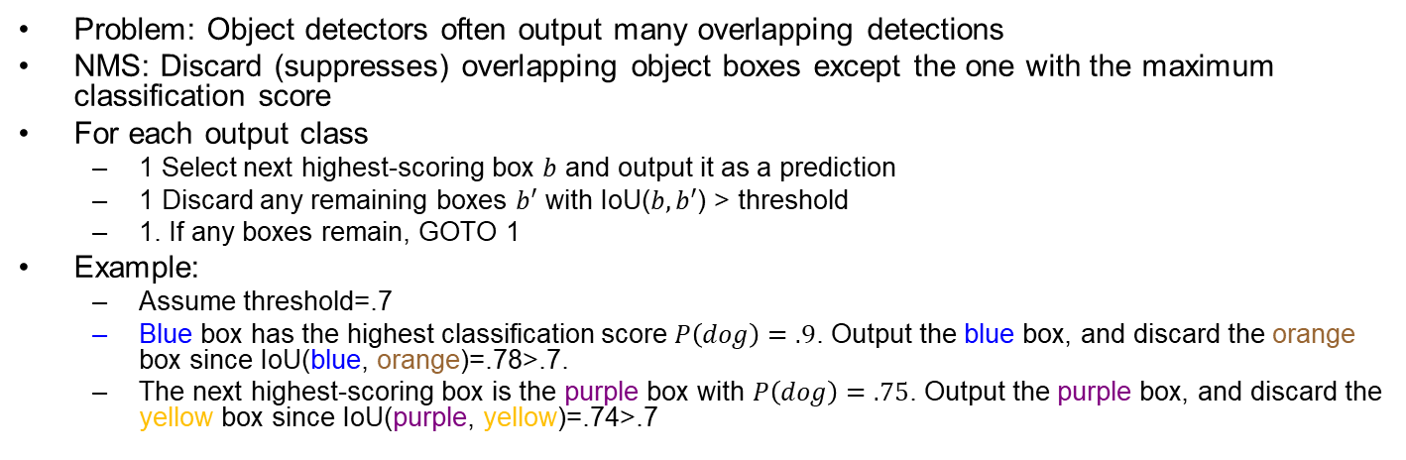
Non-Max Suppression (NMS)
Problem: Object detectors often output many overlapping detections
NMS: Discard (suppresses) overlapping object boxes except the one with the maximum classification score
For each output class
1 Select next highest-scoring box $b$ and output it as a prediction
1 Discard any remaining boxes $b′$ with IoU($b,b′$) > threshold
1. If any boxes remain, GOTO 1
Example:
Assume threshold=.7
Blue box has the highest classification score $P\left(dog\right)=.9$. Output the blue box, and discard the orange box since IoU(blue, orange)=.78>.7.
The next highest-scoring box is the purple box with $P\left(dog\right)=.75$. Output the purple box, and discard the yellow box since IoU(purple, yellow)=.74>.7
Notes:
XXX: Is it possible for multiple boxes to match (have IoU \gr threshold of) a GT box? Yes. but mAP assumes at most one box match a GT box.
Discard all the boxes having probabilities less than or equal to a pre-defined threshold (say, 0.5)
For the remaining boxes:
Pick the box with the highest probability and take that as the output prediction
Discard any other box which has IoU greater than the threshold with the output box from the above step
Repeat step 2 until all the boxes are either taken as the output prediction or discarded

Slide 9
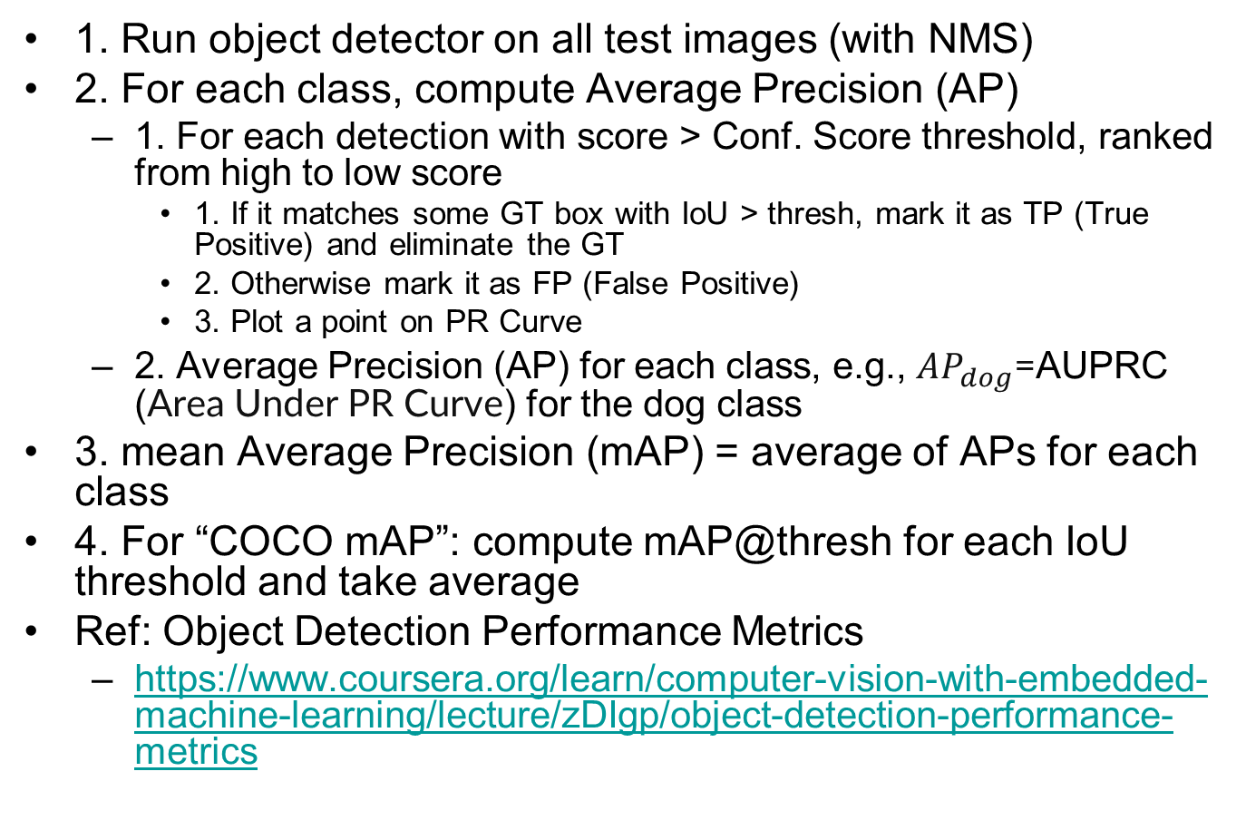
Evaluating Object Detectors: Mean Average Precision (mAP)
1. Run object detector on all test images (with NMS)
2. For each class, compute Average Precision (AP)
1. For each detection with score > Conf. Score threshold, ranked from high to low score
1. If it matches some GT box with IoU > thresh, mark it as TP (True Positive) and eliminate the GT
2. Otherwise mark it as FP (False Positive)
3. Plot a point on PR Curve
2. Average Precision (AP) for each class, e.g., $AP_{dog}$=AUPRC (Area Under PR Curve) for the dog class
3. mean Average Precision (mAP) = average of APs for each class
4. For “COCO mAP”: compute mAP@thresh for each IoU threshold and take average
Ref: Object Detection Performance Metrics
https://www.coursera.org/learn/computer-vision-with-embedded-machine-learning/lecture/zDIgp/object-detection-performance-metrics

Slide 10
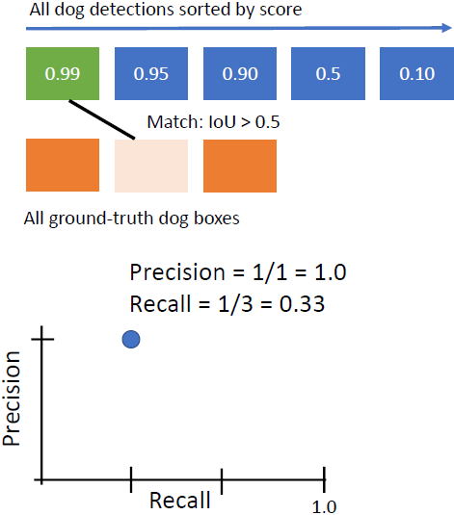
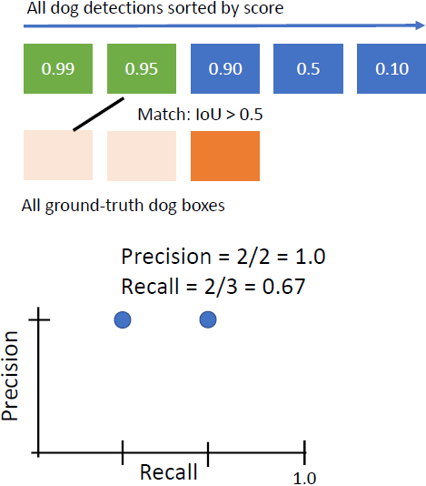
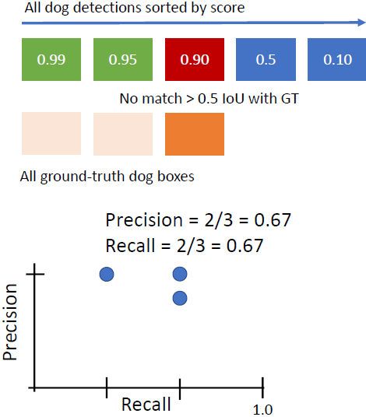
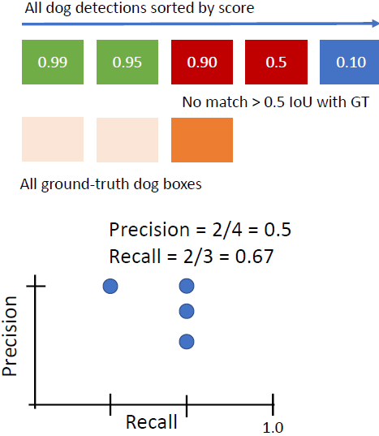
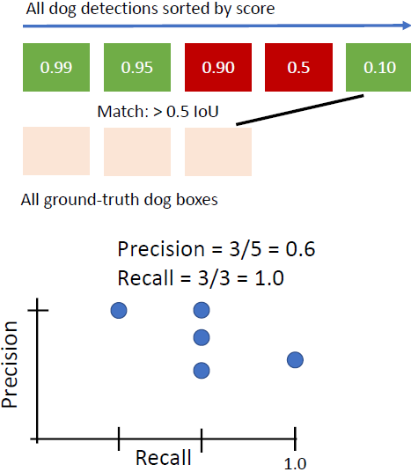
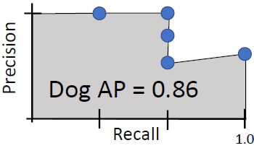
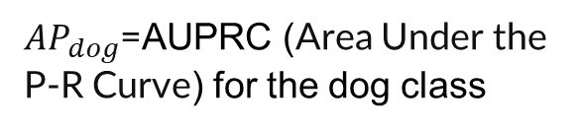
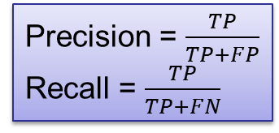
TP
TP
TP
TP
TP
FP
FN
TP
FN
TP
TP
FN
TP
TP
FN
1.0
FN=2 | TN=0
TP=1 | FP=0
FN=1 | TN=0
TP=2 | FP=0
FN=1 | TN=0
TP=2 | FP=1
1.0
TP
TP
FP
FP
TP
TP
FP
FP
TP
TP
TP
FN
TP
TP
TP
$AP_{dog}$=AUPRC (Area Under the P-R Curve) for the dog class
FN=1 | TN=0
TP=2 | FP=2
FN=0 | TN=0
TP=3 | FP=2
Precision = $\frac{TP}{TP+FP}$
Recall = $\frac{TP}{TP+FN}$
Notes:
What if two detections point to the same GT box? Not possible after NMS.

Slide 11
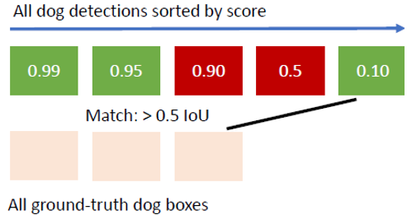

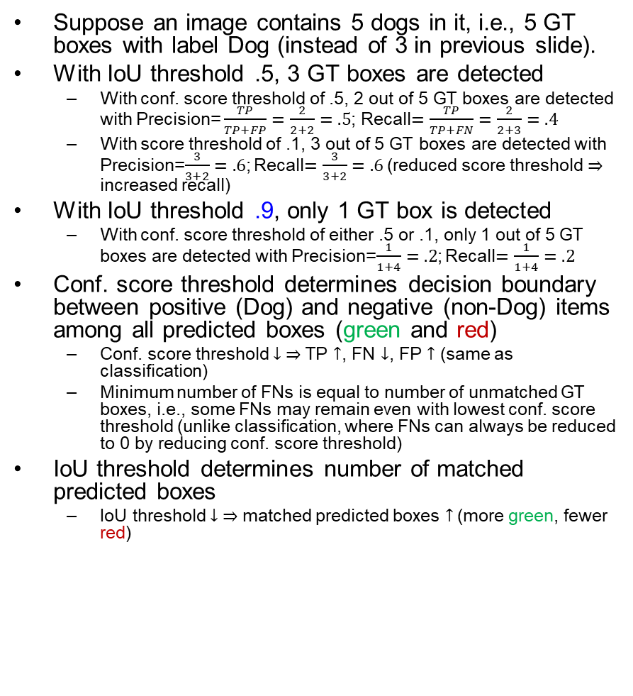



IoU Threshold and Conf. Score Threshold
TP
TP
FP
FP
0.1
Match: $≥$0.5 IoU
Suppose an image contains 5 dogs in it, i.e., 5 GT boxes with label Dog (instead of 3 in previous slide).
With IoU threshold .5, 3 GT boxes are detected
With conf. score threshold of .5, 2 out of 5 GT boxes are detected with Precision= $\frac{TP}{TP+FP}=\frac{2}{2+2}=.5$; Recall$=\frac{TP}{TP+FN}=\frac{2}{2+3}=.4$
With score threshold of .1, 3 out of 5 GT boxes are detected with Precision=$\frac{3}{3+2}=.6$; Recall$=\frac{3}{3+2}=.6$ (reduced score threshold $⇒$ increased recall)
With IoU threshold .9, only 1 GT box is detected
With conf. score threshold of either .5 or .1, only 1 out of 5 GT boxes are detected with Precision=$\frac{1}{1+4}=.2$; Recall$=\frac{1}{1+4}=.2$
Conf. score threshold determines decision boundary between positive (Dog) and negative (non-Dog) items among all predicted boxes (green and red)
Conf. score threshold $↓ ⇒$ TP $↑$, FN $↓$, FP $↑$ (same as classification)
Minimum number of FNs is equal to number of unmatched GT boxes, i.e., some FNs may remain even with lowest conf. score threshold (unlike classification, where FNs can always be reduced to 0 by reducing conf. score threshold)
IoU threshold determines number of matched predicted boxes
IoU threshold $↓ ⇒$ matched predicted boxes $↑$ (more green, fewer red)
TP
TP
TP
FN
FN
FN
TP
TP
FP
FP
TP
Match: $≥$0.5 IoU
TP
TP
TP
FN
FN
TP
FP
FP
FP
0.95
0.1
0.1
Match: $≥$0.9 IoU
FN
TP
FN
TP
TP
FN
FN
TP
FP
FP
FP
TP
0.95
0.1
FN | TN
TP | FP
Match: $≥$0.9 IoU
FN
TP
FN
TP
TP
FN
FN
Notes:
Two types of FNs in object detection FN=FN₁+FN₂:
FN₁: misclassified due to too high confidence score decision threshold among predicted boxes matching a GT box (IoU $≥$ threshold)
Shown in below fig below as brown area; shown in right fig as green boxes marked FN₁; can be reduced by reducing conf. score decision threshold
FN₂: GT boxes that are not matched by any predicted boxes (IoU $<$ threshold for all predicted boxes)
Not shown in fig below; Shown in right fig as blue boxes marked FN₂; cannot be reduced by reducing conf. score decision threshold

Slide 12


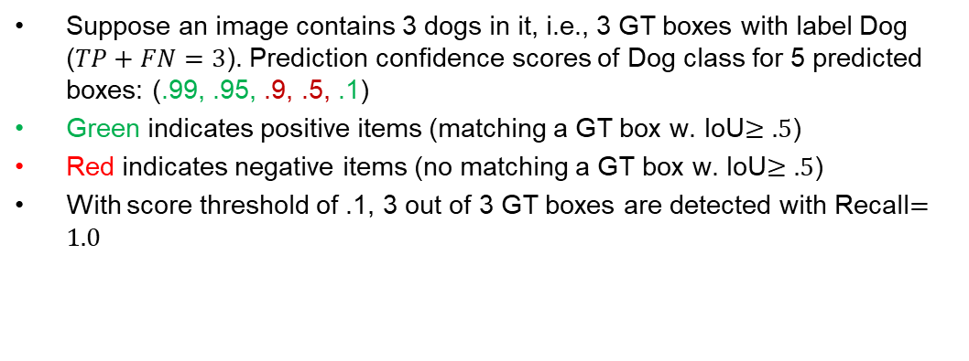







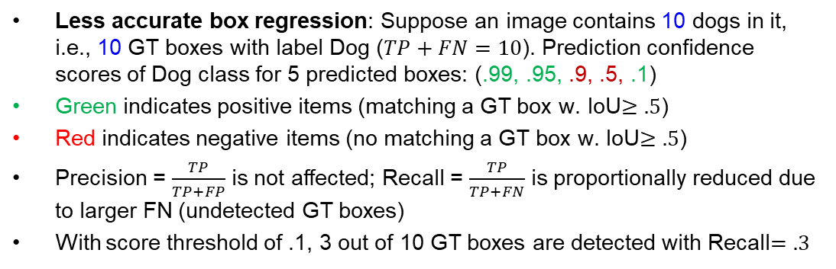

Suppose an image contains 3 dogs in it, i.e., 3 GT boxes with label Dog ($TP+FN=3$). Prediction confidence scores of Dog class for 5 predicted boxes: (.99, .95, .9, .5, .1)
Green indicates positive items (matching a GT box w. IoU$≥.5$)
Red indicates negative items (no matching a GT box w. IoU$≥.5$)
With score threshold of .1, 3 out of 3 GT boxes are detected with Recall$=1.0$
1.0
Precision
Recall
1.0
FN=2 | TN=0
TP=1 | FP=0
FN=1 | TN=0
TP=2 | FP=0
FN=1 | TN=0
TP=2 | FP=1
FN=1 | TN=0
TP=2 | FP=2
FN=0 | TN=0
TP=3 | FP=2
$$P=1.0, R=.33$$
$$P=1.0, R=.67$$
$$P=.67, R=.67$$
$$P=.5, R=.67$$
$$P=.6, R=1.0$$
Less accurate box regression: Suppose an image contains 10 dogs in it, i.e., 10 GT boxes with label Dog ($TP+FN=10$). Prediction confidence scores of Dog class for 5 predicted boxes: (.99, .95, .9, .5, .1)
Green indicates positive items (matching a GT box w. IoU$≥.5$)
Red indicates negative items (no matching a GT box w. IoU$≥.5$)
Precision = $\frac{TP}{TP+FP}$ is not affected; Recall = $\frac{TP}{TP+FN}$ is proportionally reduced due to larger FN (undetected GT boxes)
With score threshold of .1, 3 out of 10 GT boxes are detected with Recall$=.3$
1.0
Precision
Recall
1.0
FN=9 | TN=0
TP=1 | FP=0
FN=8 | TN=0
TP=2 | FP=0
FN=8 | TN=0
TP=2 | FP=1
FN=8 | TN=0
TP=2 | FP=2
FN=7 | TN=0
TP=3 | FP=2
$$P=1.0, R=.1$$
$$P=1.0, R=.2$$
$$P=.67, R=.2$$
$$P=.5, R=.2$$
$$P=.6, R=.3$$
Notes:
To get the perfect AP = 1.0, we need Precision = $\frac{TP}{TP+FP}=1.0$, Recall = $\frac{TP}{TP+FN}=1.0$, i.e., Hit all $N$ GT boxes with IoU > 0.5, and have no FP detections ranked above any TP

Slide 13

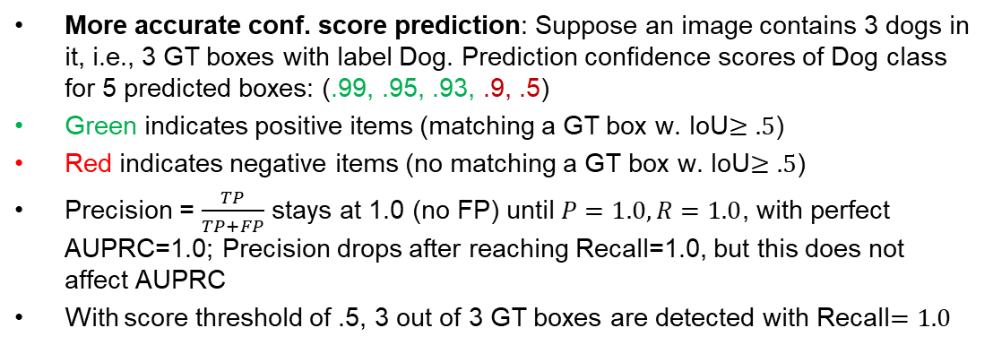



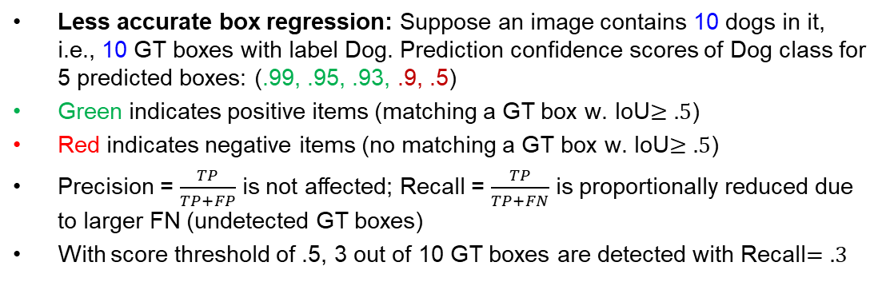
More accurate conf. score prediction: Suppose an image contains 3 dogs in it, i.e., 3 GT boxes with label Dog. Prediction confidence scores of Dog class for 5 predicted boxes: (.99, .95, .93, .9, .5)
Green indicates positive items (matching a GT box w. IoU$≥.5$)
Red indicates negative items (no matching a GT box w. IoU$≥.5$)
Precision = $\frac{TP}{TP+FP}$ stays at 1.0 (no FP) until $P=1.0, R=1.0$, with perfect AUPRC=1.0; Precision drops after reaching Recall=1.0, but this does not affect AUPRC
With score threshold of .5, 3 out of 3 GT boxes are detected with Recall$=1.0$
1.0
Precision
Recall
1.0
FN=2 | TN=0
TP=1 | FP=0
FN=1 | TN=0
TP=2 | FP=0
FN=0 | TN=0
TP=3 | FP=0
FN=0 | TN=0
TP=3 | FP=1
FN=0 | TN=0
TP=3 | FP=2
$$P=1.0, R=.33$$
$$P=1.0, R=.67$$
$$P=1.0, R=1.0$$
$$P=.75, R=1.0$$
$$P=.6, R=1.0$$
Less accurate box regression: Suppose an image contains 10 dogs in it, i.e., 10 GT boxes with label Dog. Prediction confidence scores of Dog class for 5 predicted boxes: (.99, .95, .93, .9, .5)
Green indicates positive items (matching a GT box w. IoU$≥.5$)
Red indicates negative items (no matching a GT box w. IoU$≥.5$)
Precision = $\frac{TP}{TP+FP}$ is not affected; Recall = $\frac{TP}{TP+FN}$ is proportionally reduced due to larger FN (undetected GT boxes)
With score threshold of .5, 3 out of 10 GT boxes are detected with Recall$=.3$
1.0
Precision
Recall
1.0
FN=9 | TN=0
TP=1 | FP=0
FN=8 | TN=0
TP=2 | FP=0
FN=7 | TN=0
TP=3 | FP=0
FN=7 | TN=0
TP=3 | FP=1
FN=7 | TN=0
TP=3 | FP=2
$$P=1.0, R=.1$$
$$P=1.0, R=.2$$
$$P=1.0, R=.3$$
$$P=.75, R=.3$$
$$P=.6, R=.3$$
Notes:
To get the perfect AP = 1.0, we need Precision = $\frac{TP}{TP+FP}=1.0$, Recall = $\frac{TP}{TP+FN}=1.0$, i.e., Hit all $N$ GT boxes with IoU > 0.5, and have no FP detections ranked above any TP

Slide 14


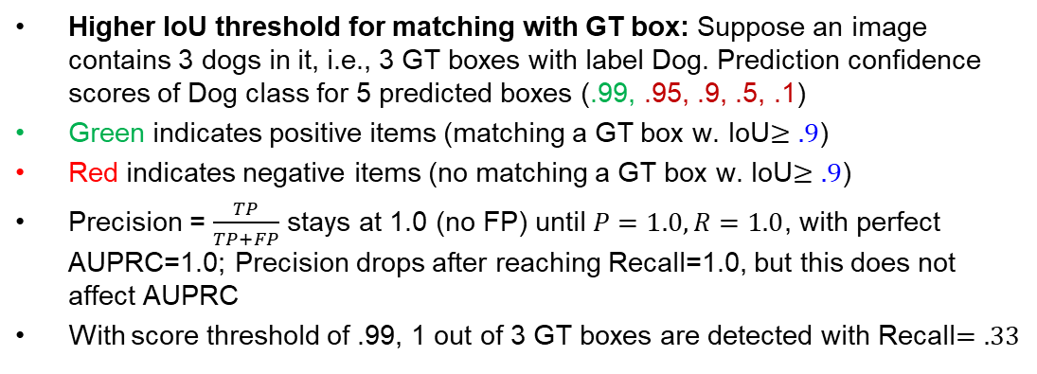





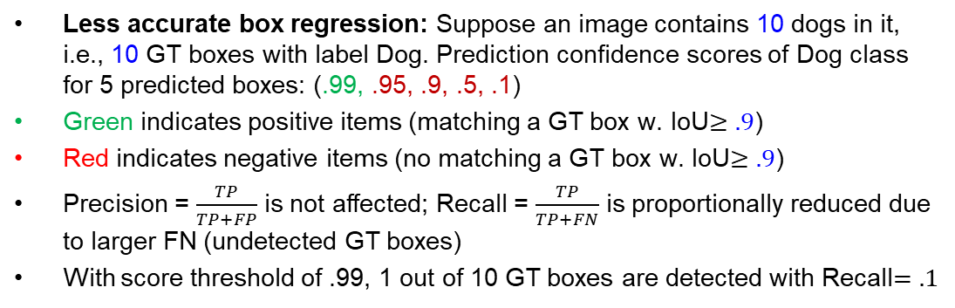

Higher IoU threshold for matching with GT box: Suppose an image contains 3 dogs in it, i.e., 3 GT boxes with label Dog. Prediction confidence scores of Dog class for 5 predicted boxes (.99, .95, .9, .5, .1)
Green indicates positive items (matching a GT box w. IoU$≥.9$)
Red indicates negative items (no matching a GT box w. IoU$≥.9$)
Precision = $\frac{TP}{TP+FP}$ stays at 1.0 (no FP) until $P=1.0, R=1.0$, with perfect AUPRC=1.0; Precision drops after reaching Recall=1.0, but this does not affect AUPRC
With score threshold of .99, 1 out of 3 GT boxes are detected with Recall$=.33$
1.0
Precision
Recall
1.0
FN=2 | TN=0
TP=1 | FP=0
FN=2 | TN=0
TP=1 | FP=1
FN=2 | TN=0
TP=1 | FP=2
FN=2 | TN=0
TP=1 | FP=3
FN=2 | TN=0
TP=1 | FP=4
$$P=1.0, R=.33$$
$$P=.5, R=.33$$
$$P=.33, R=.33$$
$$P=.25, R=.33$$
$$P=.2, R=.33$$
Less accurate box regression: Suppose an image contains 10 dogs in it, i.e., 10 GT boxes with label Dog. Prediction confidence scores of Dog class for 5 predicted boxes: (.99, .95, .9, .5, .1)
Green indicates positive items (matching a GT box w. IoU$≥.9$)
Red indicates negative items (no matching a GT box w. IoU$≥.9$)
Precision = $\frac{TP}{TP+FP}$ is not affected; Recall = $\frac{TP}{TP+FN}$ is proportionally reduced due to larger FN (undetected GT boxes)
With score threshold of .99, 1 out of 10 GT boxes are detected with Recall$=.1$
1.0
Precision
Recall
1.0
FN=9 | TN=0
TP=1 | FP=0
FN=9 | TN=0
TP=1 | FP=1
FN=9 | TN=0
TP=1 | FP=2
FN=9 | TN=0
TP=1 | FP=3
FN=9 | TN=0
TP=1 | FP=4
$$P=1.0, R=.1$$
$$P=.5, R=.1$$
$$P=.33, R=.1$$
$$P=.25, R=.1$$
$$P=.2, R=.1$$
Notes:
To get the perfect AP = 1.0, we need Precision = $\frac{TP}{TP+FP}=1.0$, Recall = $\frac{TP}{TP+FN}=1.0$, i.e., Hit all $N$ GT boxes with IoU > 0.5, and have no FP detections ranked above any TP

Slide 15
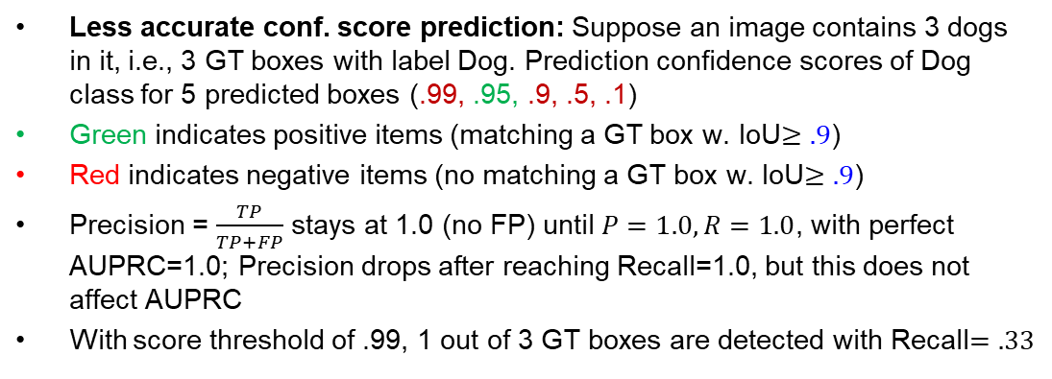


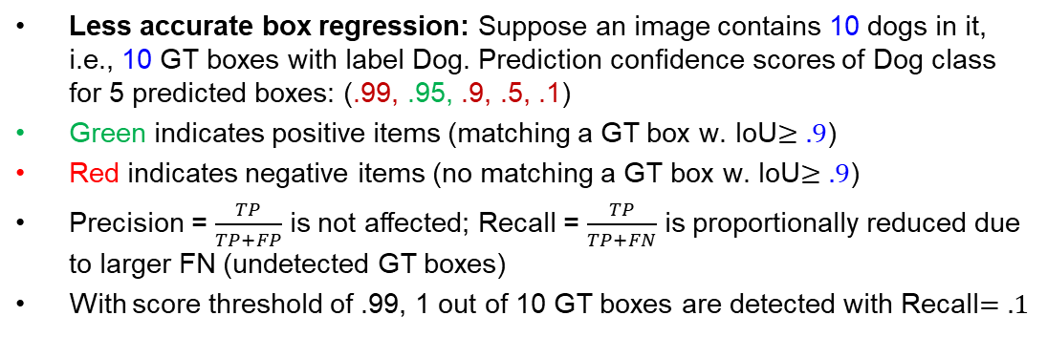
Less accurate conf. score prediction: Suppose an image contains 3 dogs in it, i.e., 3 GT boxes with label Dog. Prediction confidence scores of Dog class for 5 predicted boxes (.99, .95, .9, .5, .1)
Green indicates positive items (matching a GT box w. IoU$≥.9$)
Red indicates negative items (no matching a GT box w. IoU$≥.9$)
Precision = $\frac{TP}{TP+FP}$ stays at 1.0 (no FP) until $P=1.0, R=1.0$, with perfect AUPRC=1.0; Precision drops after reaching Recall=1.0, but this does not affect AUPRC
With score threshold of .99, 1 out of 3 GT boxes are detected with Recall$=.33$
1.0
Precision
Recall
1.0
FN=3 | TN=0
TP=0 | FP=1
FN=2 | TN=0
TP=1 | FP=1
FN=2 | TN=0
TP=1 | FP=2
FN=2 | TN=0
TP=1 | FP=3
FN=2 | TN=0
TP=1 | FP=4
$$P=0, R=0$$
$$P=.5, R=.33$$
$$P=.33, R=.33$$
$$P=.25, R=.33$$
$$P=.2, R=.33$$
Less accurate box regression: Suppose an image contains 10 dogs in it, i.e., 10 GT boxes with label Dog. Prediction confidence scores of Dog class for 5 predicted boxes: (.99, .95, .9, .5, .1)
Green indicates positive items (matching a GT box w. IoU$≥.9$)
Red indicates negative items (no matching a GT box w. IoU$≥.9$)
Precision = $\frac{TP}{TP+FP}$ is not affected; Recall = $\frac{TP}{TP+FN}$ is proportionally reduced due to larger FN (undetected GT boxes)
With score threshold of .99, 1 out of 10 GT boxes are detected with Recall$=.1$
1.0
Precision
Recall
1.0
FN=10 | TN=0
TP=0 | FP=0
FN=9 | TN=0
TP=1 | FP=1
FN=9 | TN=0
TP=1 | FP=2
FN=9 | TN=0
TP=1 | FP=3
FN=9 | TN=0
TP=1 | FP=4
$$P=0, R=0$$
$$P=.5, R=.1$$
$$P=.33, R=.1$$
$$P=.25, R=.1$$
$$P=.2, R=.1$$
Notes:
To get the perfect AP = 1.0, we need Precision = $\frac{TP}{TP+FP}=1.0$, Recall = $\frac{TP}{TP+FN}=1.0$, i.e., Hit all $N$ GT boxes with IoU > 0.5, and have no FP detections ranked above any TP

Slide 16
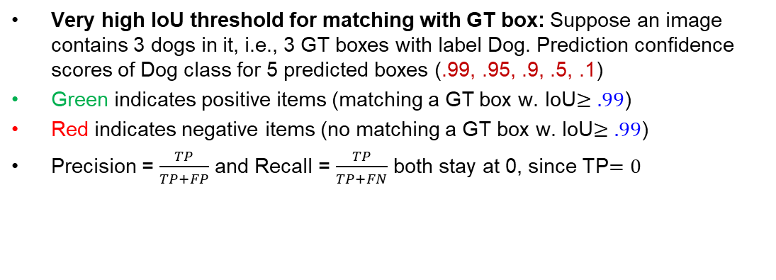
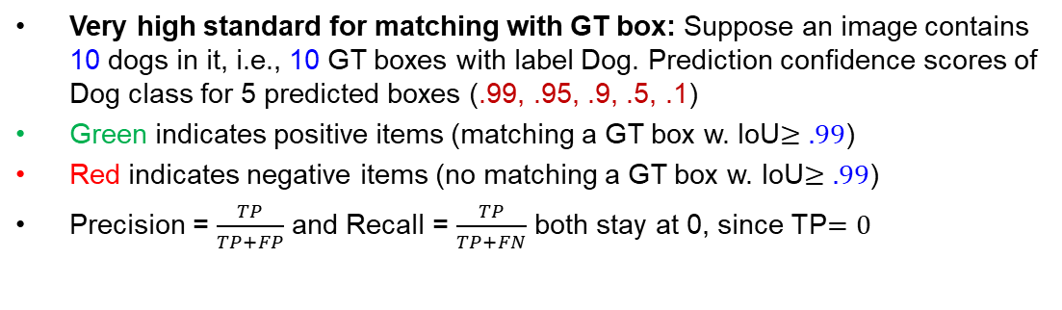

Very high IoU threshold for matching with GT box: Suppose an image contains 3 dogs in it, i.e., 3 GT boxes with label Dog. Prediction confidence scores of Dog class for 5 predicted boxes (.99, .95, .9, .5, .1)
Green indicates positive items (matching a GT box w. IoU$≥.99$)
Red indicates negative items (no matching a GT box w. IoU$≥.99$)
Precision = $\frac{TP}{TP+FP}$ and Recall = $\frac{TP}{TP+FN}$ both stay at 0, since TP$=0$
1.0
Precision
Recall
1.0
FN=3 | TN=0
TP=0 | FP=1
FN=3 | TN=0
TP=0 | FP=2
FN=3 | TN=0
TP=0 | FP=3
FN=3 | TN=0
TP=0 | FP=4
FN=3 | TN=0
TP=0 | FP=5
$$P=0, R=0$$
$$P=0, R=0$$
$$P=0, R=0$$
$$P=0, R=0$$
$$P=0, R=0$$
Very high standard for matching with GT box: Suppose an image contains 10 dogs in it, i.e., 10 GT boxes with label Dog. Prediction confidence scores of Dog class for 5 predicted boxes (.99, .95, .9, .5, .1)
Green indicates positive items (matching a GT box w. IoU$≥.99$)
Red indicates negative items (no matching a GT box w. IoU$≥.99$)
Precision = $\frac{TP}{TP+FP}$ and Recall = $\frac{TP}{TP+FN}$ both stay at 0, since TP$=0$
1.0
Precision
Recall
1.0
FN=10 | TN=0
TP=0 | FP=0
FN=10 | TN=0
TP=0 | FP=2
FN=10 | TN=0
TP=0 | FP=2
FN=10 | TN=0
TP=0 | FP=2
FN=10 | TN=0
TP=0 | FP=2
$$P=0, R=0$$
$$P=0, R=0$$
$$P=0, R=0$$
$$P=0, R=0$$
$$P=0, R=0$$
Notes:
To get the perfect AP = 1.0, we need Precision = $\frac{TP}{TP+FP}=1.0$, Recall = $\frac{TP}{TP+FN}=1.0$, i.e., Hit all $N$ GT boxes with IoU > 0.5, and have no FP detections ranked above any TP

Slide 17
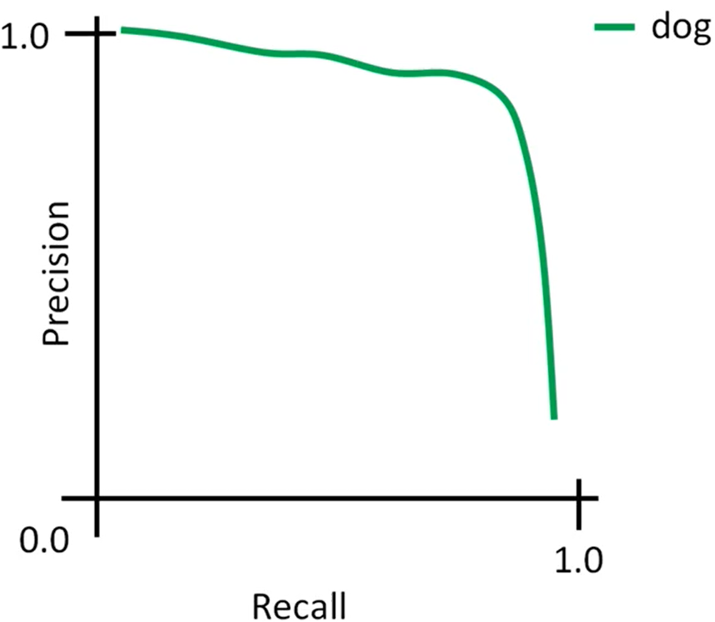
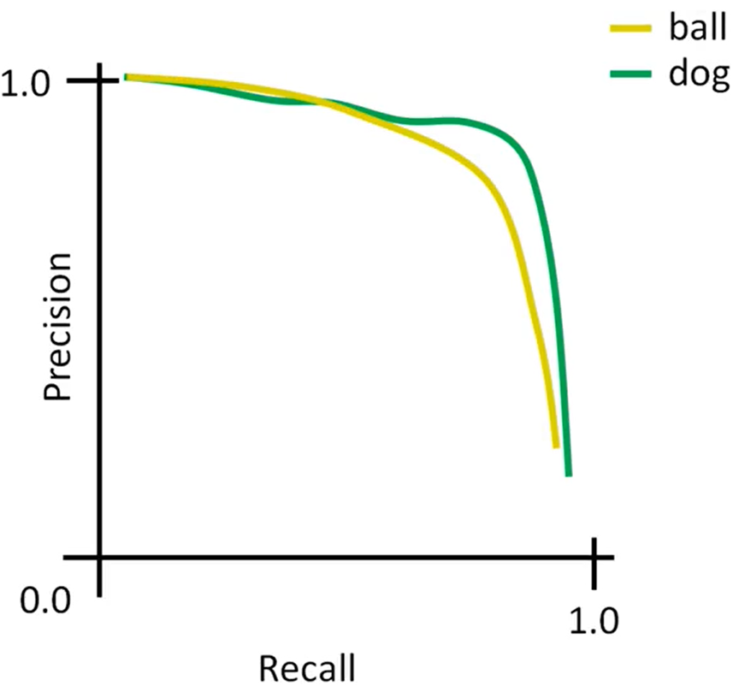
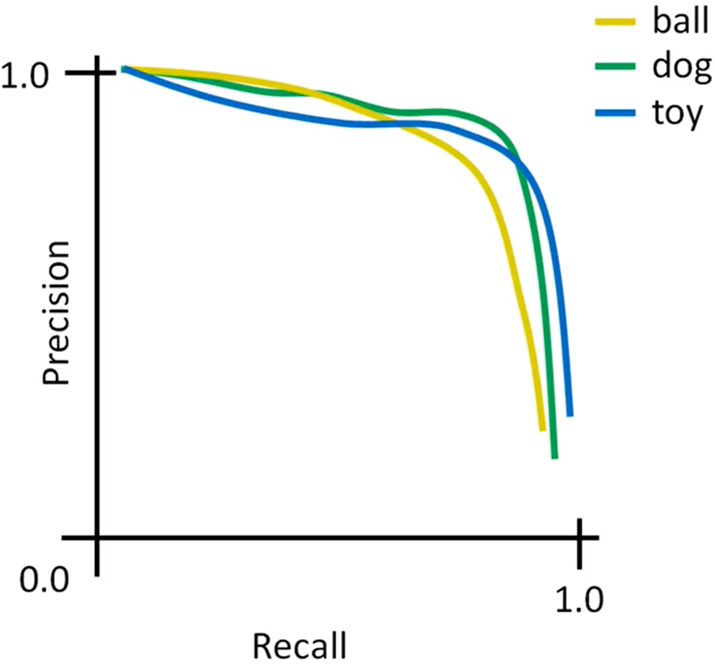
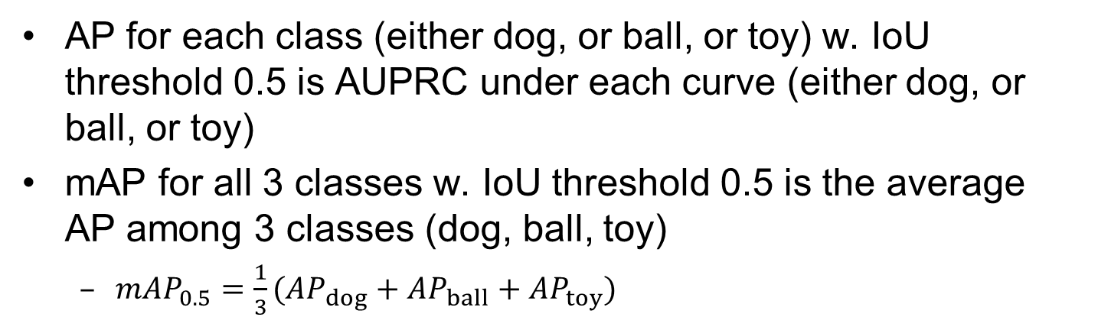
mean Average Precision (mAP)
AP for each class (either dog, or ball, or toy) w. IoU threshold 0.5 is AUPRC under each curve (either dog, or ball, or toy)
mAP for all 3 classes w. IoU threshold 0.5 is the average AP among 3 classes (dog, ball, toy)
$mAP_{0.5}=\frac{1}{3}(AP_{dog}+AP_{ball}+AP_{toy})$
Notes:
Suppose we have 3 classes, and have computed AP values for each classwith IoU threshold .5 as:
Car AP = .65, Cat AP = .80, Dog AP = .86, then mAP@.5=.77

Slide 18
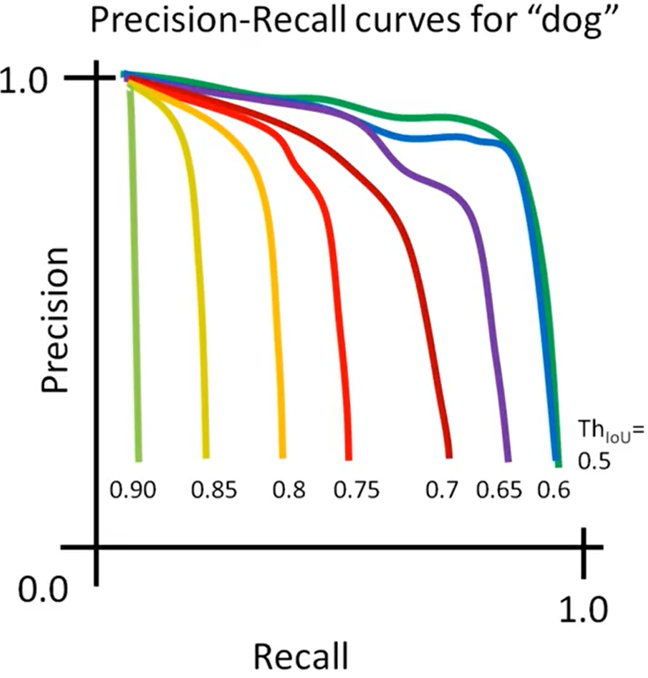
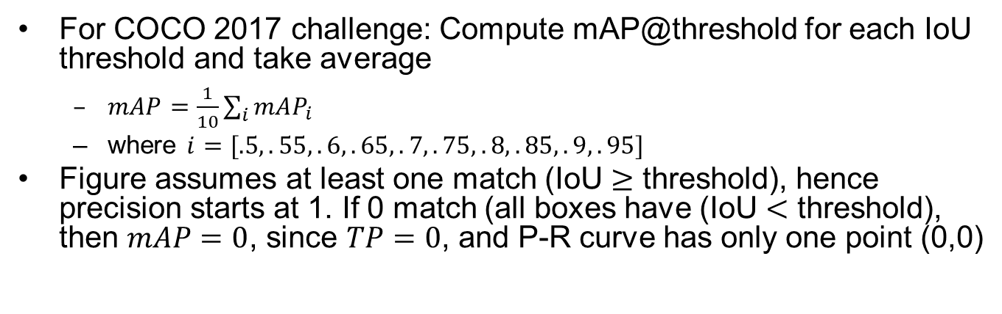
mAP
For COCO 2017 challenge: Compute mAP@threshold for each IoU threshold and take average
$mAP=\frac{1}{10}\sum_{i}{mAP_{i}}$
where $i=[.5,.55,.6,.65,.7,.75,.8,.85,.9,.95]$
Figure assumes at least one match (IoU $≥$ threshold), hence precision starts at 1. If 0 match (all boxes have (IoU $<$ threshold), then $mAP=0$, since $TP=0$, and P-R curve has only one point (0,0)
Notes:
But FP

Slide 19
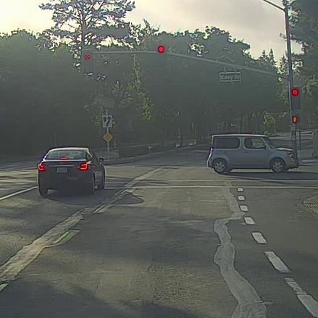
Detecting Multiple Objects: Sliding Window
Slide a box across the image, and apply a CNN to classify each image patch as object or background
https://www.coursera.org/learn/convolutional-neural-networks/lecture/VgyWR/object-detection

Slide 20
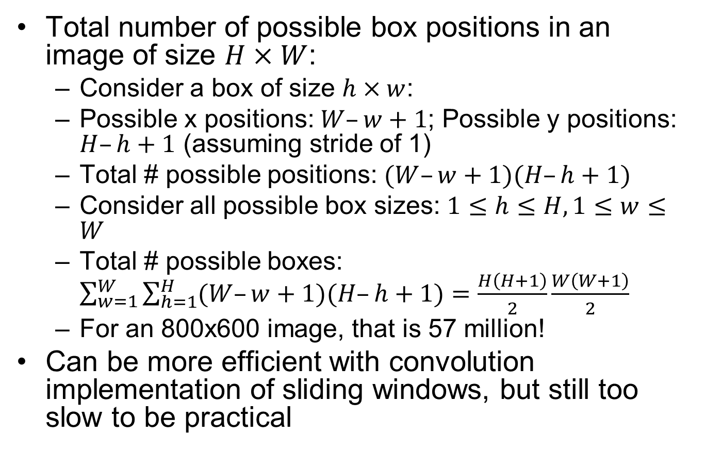
Sliding Window Computational Complexity
Total number of possible box positions in an image of size $H×W$:
Consider a box of size $h×w$:
Possible x positions: $W–w+1$; Possible y positions: $H–h+1$ (assuming stride of 1)
Total # possible positions: $(W–w+1)(H–h+1)$
Consider all possible box sizes: $1≤h≤H,1≤w≤W$
Total # possible boxes: $\sum_{w=1}^{W}{\sum_{h=1}^{H}{(W–w+1)(H–h+1)}}=\frac{H\left(H+1\right)}{2}\frac{W\left(W+1\right)}{2}$
For an 800x600 image, that is 57 million!
Can be more efficient with convolution implementation of sliding windows, but still too slow to be practical

Slide 21
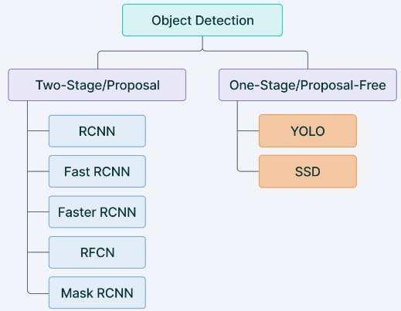
Two-stage vs. One-Stage Detector
Two-stage detector
1st step: generate Regions of Interests (Region Proposals) that are likely to contain objects
2nd step: perform object detection, incl. classification and regression of Bboxes of the objects
One-stage detector
Directly perform object detection, incl. classification and regression of Bboxes of the objects
Notes:
RCNN, Fast RCNN, SPPNET, Faster RCNN, etc., are some of the two-stage detectors. YOLO, YOLO v2, SSD, RetinaNet, etc., fall under one phase detector. Object detection is an advanced form of imaging classification where a neural network predicts objects in an image and draws attention to them in the form of Bboxes.

Slide 22
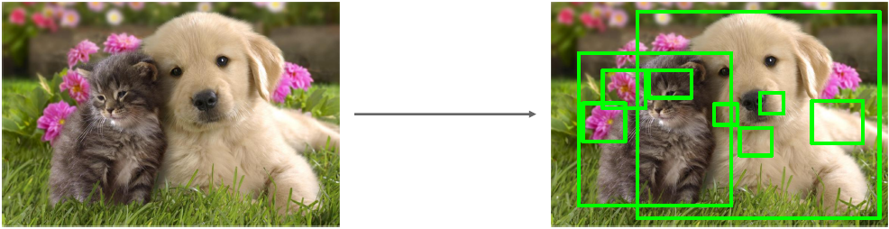
Region Proposals
Generating region proposals: find a small set of boxes that are likely to cover all objects, based on Selective Search, e.g., look for “blob-like” image regions
Relatively fast to run: e.g. can generate ~2000 region proposals in a few seconds on CPU
Notes:
Fast RCNN uses selective search for generating Regions of Interest,

Slide 23
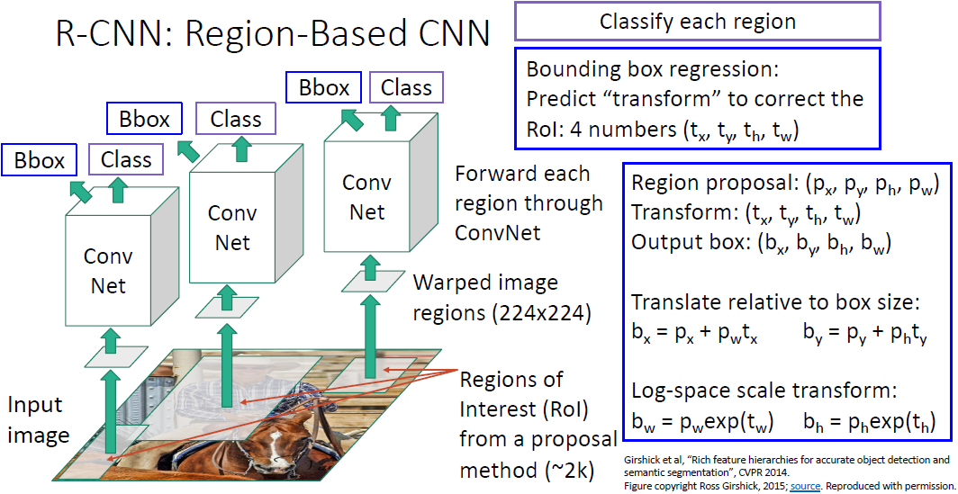
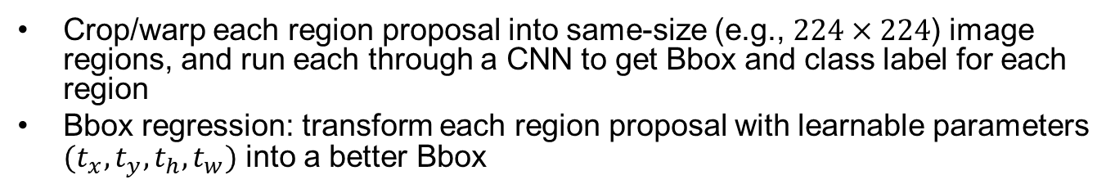
R-CNN: Training Time
Important
Crop/warp each region proposal into same-size (e.g., $224×224$) image regions, and run each through a CNN to get Bbox and class label for each region
Bbox regression: transform each region proposal with learnable parameters $(t_{x},t_{y},t_{h},t_{w})$ into a better Bbox

Slide 24
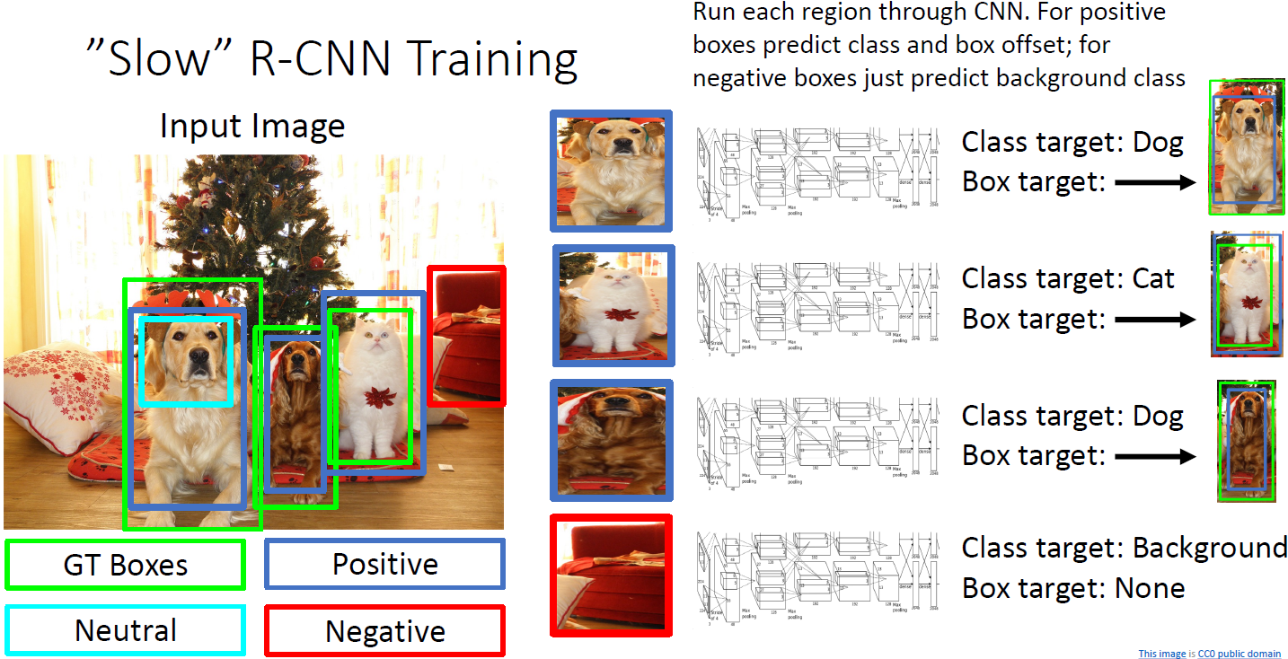
R-CNN Training Example
Categorize each region proposal as positive, negative, or neutral based on overlap with ground-truth boxes
Crop pixels from each positive and negative proposal, resize to 224 x 224
Use the CNN for Bbox regression and classification for positive boxes; only 1-class prediction for negative boxes

Slide 25
R-CNN: Test Time
1. Run region proposal method to compute ~2000 region proposals
2. Resize each region to 224x224 (tunable hyperparam) and run independently through the CNN to get feature vectors, then use Linear SVM to predict class scores, and Linear Regression to predict Bboxes
3. Use scores to select a subset of region proposals to output
Many choices here: threshold on background score (e.g., output bottom K proposals with lowest background scores), or per-class (e.g., output top K proposals with highest classification scores for the given class)…
4. Compare with ground-truth Bboxes
Notes:
Input: Single Image
, Or take top K proposals per image?

Slide 26
R-CNN is Slow
Inference time: ~40-50s per image
Extracting ~2000 regions for each image based on selective search
Extracting feature vectors using CNN for every image region.
Suppose we have N images, then the number of CNN features will be N*2000
Notes:
The entire process of object detection using RCNN has three models:
CNN for feature extraction
Linear SVM classifier for identifying objects
Regression model for tightening the Bboxes.

Slide 27

Fast R-CNN
Important
1. Use a backbone network to extract feature maps from the whole image
2. Apply Selective Search on these feature maps and get object proposals
3. Use a lightweight Per-Region network to perform Bbox regression and classification
Most of the computation happens in backbone network; this saves work for overlapping region proposals compared to R-CNN
(RoI Pooling)
(Selective Search)
Notes:
Take an input image and pass it to the ConvNet which returns feature maps for the image
Apply Region Proposal Network (RPN) on these feature maps and get object proposals.. Generate region proposals based on the feature maps;
Apply ROI pooling layer to bring down all the proposals to the same size
Finally, pass these proposals to a fully connected layer in order to classify any predict the Bboxes for the image

Slide 28

Fast R-CNN Training Example
Heavyweight CNN for
extracting feature maps
Lightweight NN for Bbox regression & classification

Slide 29


Example Backbone and Per-Region Networks
When using AlexNet for detection, 5 CONV layers are used for backbone and 2 FC layers are used for per-region network
For ResNet, the last stage (CONV+FC) is used as per-region network; the rest of the network is used as backbone
AlexNet
ResNet
Notes:
Inference time: ~40-50s per image

Slide 30

Fast R-CNN Performance
Problem: Test time of Fast R-CNN is dominated by region proposals
Solution: instead of using the heuristic ”Selective Search” algorithm on CPU, let’s learn them with a CNN instead

Slide 31

Faster R-CNN
Use Region Proposal Network (RPN) to generate region proposals from feature maps output by the backbone network
vs. Selective Search used by Fast R-CNN
RPN is learnable/trainable; Selective Search is a fixed heuristic algorithm
The rest the same as Fast R-CNN
Notes:
Take an input image and pass it to the ConvNet which returns feature maps for the image
Apply Region Proposal Network (RPN) on these feature maps and get object proposals
Apply ROI pooling layer to bring down all the proposals to the same size
Finally, pass these proposals to a fully connected layer in order to classify any predict the Bboxes for the image
Fast RCNN uses selective search for generating Regions of Interest, while Faster RCNN uses “Region Proposal Network”, aka RPN. RPN takes image feature maps as an input and generates a set of object proposals, each with an objectness score as output.
RPN takes image feature maps as an input and generates a set of object proposals, each with an objectness score as output.

Slide 32

Faster R-CNN: Loss Function
Notes:
Jointly train with 4 losses:
1. RPN classification: anchor box is object / not an object
2. RPN regression: predict transform from anchor box to proposal box
3. Object classification: classify proposals as background / object class
4. Object regression: predict transform from proposal box to object box

Slide 33



3 Variants of R-CNN
R-CNN
Faster R-CNN
Fast R-CNN

Slide 34
Summary of 3 Variants of R-CNN
Algorithm | Characteristics | Pred. Time/Img (s) | Limitations
R-CNN | Use Selective Search on the input image to generate regions. Extracts ~2000 regions from each image. | 40-50 | High computation time as each region is passed to the CNN separately
Fast R-CNN | Each image is passed only once to the CNN and feature maps are extracted. Use Selective Search on feature maps to generate predictions. Combines all the three models used in RCNN together. | 2 | Relatively high computation time using selective search
Faster R-CNN | Replaces Selective Search with Region Proposal Network to make the algorithm much faster. | 0.2
Notes:
; also it uses three different model for making predictions.

Slide 35
Two-stage vs. One-Stage Detector
Two-stage detector
1st step: generate Regions of Interests (Region Proposals) that are likely to contain objects
2nd step: perform object detection, incl. classification and regression of Bboxes of the objects
One-stage detector
Directly perform object detection, incl. classification and regression of Bboxes of the objects
Notes:
RCNN, Fast RCNN, SPPNET, Faster RCNN, etc., are some of the two-stage detectors. YOLO, YOLO v2, SSD, RetinaNet, etc., fall under one phase detector. Object detection is an advanced form of imaging classification where a neural network predicts objects in an image and draws attention to them in the form of Bboxes.

Slide 36

YOLO
Divide the input image into n-by-n grids
For each grid, predict Bboxes and their class labels for objects (if any are found)
The Bboxes are highlighted by yellow color in the second step.
Apply Non-Maximal Suppression based on IoU, we suppress Bboxes with lower probability scores to achieve final Bboxes
Notes:
1. Residual boxes: divide the image into grids of fixed dimensions, say n*n. Every cell tries to detect objects within them.
2. Bbox regression: It is an outline that highlights an object in an image. Its attributes are height, width, class(of the object), and box center(bx, by).
3. IoU: It describes how boxes overlap..
We can see in the above image how the residual boxes are generated.
The Bboxes are highlighted by yellow color in the second step of the image above.
The IOU equals 1 if the predicted Bbox is the same as the real box. This mechanism eliminates Bboxes that are not equal to the real box. IOU is calculated as the ratio of ‘area of overlap’ to ‘area of the union’. Finally, by Non-Maximal Suppression, YOLO suppresses all Bboxes with lower probability scores to achieve final Bboxes

Slide 37


Label for a Grid cell
Suppose we divide the image into a 3x3 grid. We define 3 classes (Pedestrian, Car, Motorcycle)
For each grid cell, the label y is an 8-D vector
p_{c} defines whether an object is present in the grid or not (it is the probability)
(b_{x}, b_{y}, b_{h}, b_{w}) specify the Bbox if there is an object
(c₁, c₂, c₃) represent one-hot vector as the target label (or the class confidence scores computer by SoftMax during inference)
For each of the 3x3 grid cells, we have an 8-D output vector. So the output dimension is 3x3x8
Even if an object may span more than one grid, it will only be assigned to a single grid cell in which its mid-point is located
Notes:
es. So, if the object is a car, c₂ will be 1 and c_{1 &} c₃ will be 0, and so on
The output volume has shape of 3x3x8
(with 3x3 grid and 3 classes)

Slide 38



Two Grid Cells
Since there is no object in this grid, pc=0, and all the other entries are ?
Since there is an object (Car) in this grid, pc=1. (bx, by, bh, bw) are calculated relative to the particular grid cell
Class label is (0,1,0) since Car is the 2nd class
Notes:
pc will be zero and
Here, ‘?’ means that it doesn’t matter what bx, by, bh, bw, c1, c2, and c3 contain as there is no object in the grid.
the y label for this grid is: ‘?’ means that it doesn’t matter what the other entries are

Slide 39


An Example Grid Cell
(b_{x}, b_{y})=(0.4, 0.3): coordinates of the midpoint of the object with respect to this grid
(b_{h}, b_{w})=(0.5, 0.9):
b_{h} = 0.5 is ratio of the height of the Bbox (red box) to the height of the grid cell
b_{w} = 0.9 is ratio of the width of the Bbox to the width of the grid cell
b_{x} and b_{y} will never exceed 1, as the midpoint will always lie within the grid. Whereas b_{h} and b_{w} can exceed 1 if the dimensions of the Bbox are more than the dimension of the grid
Class label is (0,1,0) for the Car class
=
0.5
0.9
0.5

Slide 40



Anchor Boxes
Place $K$ anchor boxes centered at each position in the feature map, each with different sizes and aspect ratios ($K=2$ in the fig)
This allows detection of multiple objects centered at the same position, and better-fitting anchor boxes, which helps ease the downstream Bbox regression task

Slide 41



Anchor Boxes
Suppose we have 2 anchor boxes for each grid cell. Then we can detect at most two objects for each grid cell
First 8 rows of the y label belong to anchor box 1 and the remaining 8 belongs to anchor box 2. The y vector has 16 entries, and the output has dimension 3x3x2x8=3x3x16
The objects are assigned to the anchor boxes based on the similarity of the Bboxes and the anchor box shape, e.g., the person is assigned to anchor box 1 and the car is assigned to anchor box 2
Suppose we use 5 anchor boxes per grid and the number of classes is 5, then the output has dimension 3x3x5x10= 3x3x50
Notes:
The output volume is 3x3x8 (with a 3x3 grid and 3 classes)
The output dimension is SxSx(5B+C), where SxS is the image size; B is number of anchor boxes per grid cell; C is number of classes

Slide 42
Realistic YOLO Dimensions
Input image has shape (608, 608, 3)
The CNN output has dimension (19, 19, 5, 85), where each grid cell returns 5*85 numbers, with total dimension of 19*19*5*85
5 is the number of anchor boxes per grid
85 = 5+80, where 5 refers to (pc, bx, by, bh, bw), and 80 is the number of classes
Finally, compute IoU and perform Non-Max Suppression
Notes:
The last two dimensions of the above output are flattened to get an output volume of (19, 19, 425):

Slide 43

YOLO with FPN
Backbone extracts essential features of an image and feeds them to the Head through Neck
Neck is a Feature Pyramid Network (FPN) that collects feature maps extracted by the Backbone and creates feature pyramids
An FPN is a feature extractor that takes a single-scale image of an arbitrary size as input, and outputs proportionally sized feature maps at multiple levels
Head consists of output layers that make final detections.
Notes:
Based on FCNN (Fully Convolutional Neural Network)
The model has 24 convolutional layers followed by 2 fully connected layers.
, in a fully convolutional fashion. This process is independent of the backbone convolutional architectures.
It takes in an input image of dimensions 224 x 224 and resizes it to 448 x 448 for the detection task. The output is a 7 x 7 x 30 tensor containing predictions which the model makes on the input image Based on FCNN (Fully Convolutional Neural Network)
Backbone extracts essential features of an image and feeds them to the Head through Neck.
Neck collects feature maps extracted by the Backbone and creates feature pyramids.
Head consists of output layers that have final detections.

Slide 44

Performance Comparisons (2017)
Two stage method (Faster R-CNN) get the best accuracy, but are slower
Single-stage methods (SSD) are much faster, but don’t perform as well
Bigger backbones improve performance, but are slower
Inference Time (ms)
Notes:
Diminishing returns for slower methods

Slide 45

Summary of Object Detectors
Important
backbone network
to generate feature
maps once
RPN

Slide 46

Outline
Object detection
Segmentation
https://medium.com/hackernoon/semantic-segmentation-datasets-for-autonomous-driving-1182ebd2aff0

Slide 47


Types of Segmentation Tasks
Things vs. stuff
Things: Object categories that can be separated into object instances (e.g. cats, cars, person)
Stuff: Object categories that cannot be separated into instances (e.g. sky, grass, water, trees)
Object Detection vs. Semantic Segmentation vs. Instance Segmentation
Object Detection: Detects object instances, but only gives Bbox (things only)
Semantic Segmentation: Label all pixels, but merges instances (both things and stuff)
Instance Segmentation: Detect all object instances and label the pixels that belong to each object (things only)
Approach: Perform object detection, then predict a segmentation mask for each object
Panoptic Segmentation: In addition to Instance Segmentation, also label the pixels that belong to each thing
Semantic Segmentation
Instance Segmentation
Panoptic Segmentation
Notes:
Gives per-pixel labels

Slide 48

Semantic Segmentation: Task Definition
Label each pixel in the image with a class label
Don’t differentiate among multiple instances (e.g., pixels of the 2 cows are given the same label)
Notes:
, only care about pixels

Slide 49

An Early Approach: Sliding Windows
Slide a box across the image, and apply a CNN to classify each crop’s center pixel
Inefficient, not reusing shared features between overlapping patches
Notes:
Not
reusing shared features
between overlapping patches

Slide 50

Fully Convolutional Network (FCN)
A CNN with only CONV layers, no FC layers, for making predictions for all pixels all at once. Loss function is per-pixel Cross-Entropy loss
Problem #1: Effective receptive field size grows linearly in the feedforward direction with number of CONV layers: with L 3x3 CONV layers, receptive field grows slowly as 2L+1 (3x3, 5x5, 7x7…)
Problem #2: Convolution on high-res images without downsampling is expensive
Notes:
Recall ResNet stem aggressively
downsamples

Slide 51


Ground Truth Per-Pixel Labels

Slide 52

Ground Truth Per-Pixel Labels
One output channel for each of the 5 possible classes.
Pixel-wise Cross-Entropy Loss
Notes:
$−\sum_{classes}{y_{true}\log{(y_{pred})}}$

Slide 53

More Efficient FCN
A CNN with CONV layers that perform downsampling followed by upsampling
Downsampling (with pooling or strided convolution) allows effective receptive field size to grow more quickly in the feedforward direction. It also leads to more efficient computation
Upsampling with interpolation or transposed convolution to get same-size output as input
D₃ x H/8 x W/8

Slide 54

Unpooling for Upsampling
Upsampling from a 2x2 image to a 4x4 image, by either inserting 0s (Bed of Nails), or duplicating elements (Nearest Neighbor)

Slide 55


Bilinear/Bicubic Interpolation for Upsampling
Upsampling from a 2x2 image to a 4x4 image with bilinear (left) and bicubic (right) interpolation, to generate smoother outputs
Each output element is computed as a linear or cubic combination of its closest neighbors; closer neighbors are given higher weights
Bilinear: use 4 closest neighbors in x and y to construct linear approximations
Bicubic: use 3 closest neighbors in x and y to construct cubic approximations

Slide 56

Max Unpooling

Slide 57

Recall: Regular Convolution

Slide 58


Learnable Upsampling: Transposed Convolution
(can also trim from bottom and right, or bottom and left…)

Slide 59

Transposed Convolution 1D Example
Fig shows a 1D example of size 3 filter, stride 2:
Output has copies of filter weighted by input
Move 2 pixels in output for each pixel in input
Sum at overlaps (az+bx)
Crop one pixel (either top or bottom) to make output 2x input
The filter moves at a slower pace than with unit stride
It has many names: Transposed Convolution, Deconvolution, Upconvolution, Fractionally-strided convolution

Slide 60

Semantic Segmentation: Fully Convolutional Network

Slide 61

Mask R-CNN for Instance Segmentation
Important
Add an extra “Mask Prediction” head on top of Faster R-CNN for Object Detection

Slide 62

Mask R-CNN for Instance Segmentation
Notes:
Is missing a regression head?

Slide 63

Example Target Segmentation Masks
Target segmentation mask
for class “chair” in the Bbox
Target segmentation mask
for class “person” in the Bbox

Slide 64

Mask R-CNN for Keypoint Estimation
Add an extra “Keypoint Prediction” head to perform joint Instance Segmentation and Pose Estimation
Example keypoints: left/right shoulder, elbow, wrist, hip, knee, ankle…

Slide 65


Mask R-CNN: Keypoints

Slide 66

Summary of Per-Region Heads for Different Tasks
Important

